Slide 1

Generative Adversarial Nets
Deep Learning in Earth Science v2 Lecture 5
By Xiao Zhuowei
10.25.2019

Slide 2
OUTLINES
OUTLINES
1
Generative Models
2
Fundaments
3
GAN Extensions
4
Discussion

Slide 3
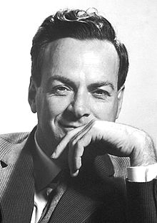
Generative Models
Generative models: Describing how data is generated by estimating the joint probability distribution of data P(X, Y) between the observed data X and corresponding labels Y.
The probability distribution of true data p(x) can be a very complicated distribution and intractable (e.g., images)
“What I cannot create, I do not understand.”
—Richard Feynman

Slide 4
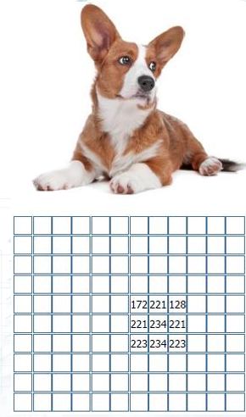
Generative Models
Human: a dog with four legs
Computer: a grid of numbers
How to train computers to understand concepts without being explicitly taught the meaning of those concepts ?
Data-driven learning
Basic understanding of concepts

Slide 5
Generative Models
Types of generative models are:
Gaussian mixture model (and other types of mixture model)
Hidden Markov model
Probabilistic context-free grammar
Bayesian network (e.g. Naive bayes, Autoregressive model)
Averaged one-dependence estimators
Latent Dirichlet allocation
Boltzmann machine (e.g. Restricted Boltzmann machine, Deep belief network)
Variational autoencoder
Generative adversarial network
Flow-based generative model

Slide 6
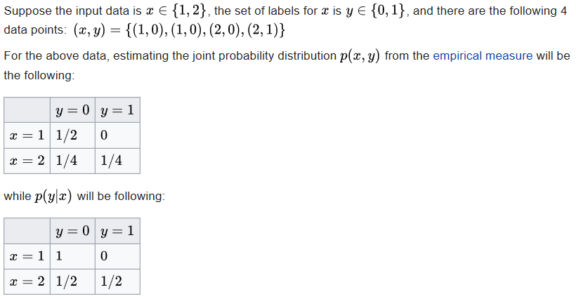
Simple example
Generative Models
https://en.wikipedia.org/wiki/Generative_model

Slide 7
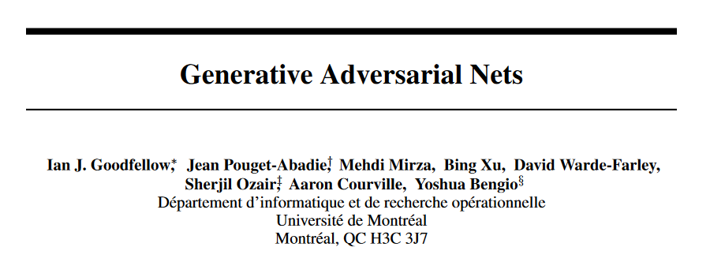
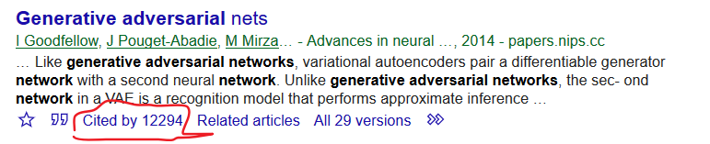
Generative Models
Advances in Neural Information Processing Systems 27 (NIPS 2014)

Slide 8
OUTLINES
OUTLINES
1
Generative Models
2
Fundaments
3
GAN Extensions
4
Discussion

Slide 9
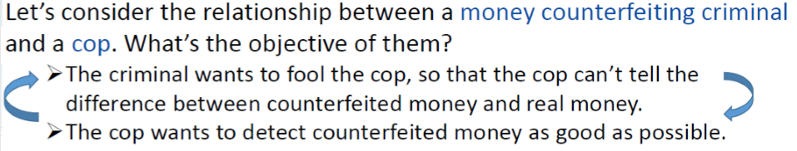


Fundaments
Adversarial Process in Game Theory
They fight against each other, endlessly attempting to outdo each other. In the process, they both become stronger. This process is called Adversarial Process in mini-max game model in Game Theory.

Slide 10
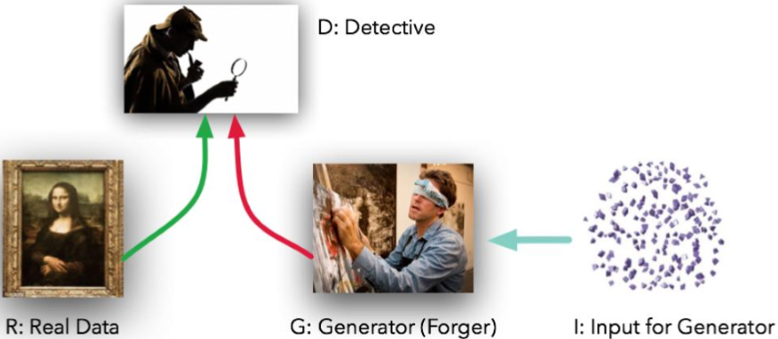
Fundaments
GAN is a special case of Adversarial Process where the components are neural networks.
The first net Generate Net G generates fake data G(z) from the input random vector z.
The second net Discriminator Net D tries to tell the difference between the real data x and the fake data G(z).

Slide 11
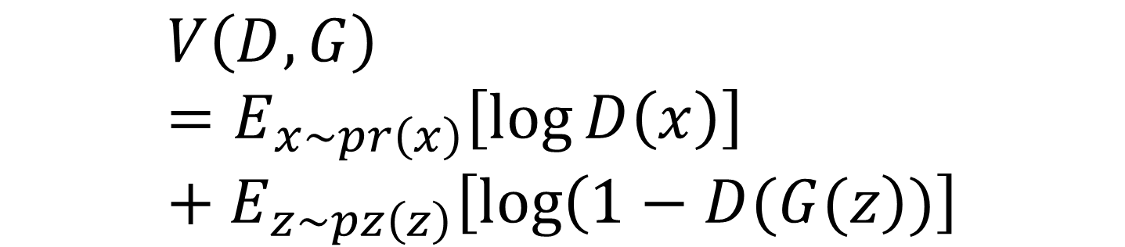
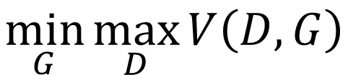
Fundaments
Objection function of GAN
$$\min_{G}{\max_{D}{V\left(D,G\right)}}$$
$$V\left(D,G\right)=E_{x\sim pr\left(x\right)}\left[\log{D\left(x\right)}\right]+E_{z\sim pz\left(z\right)}\left[\log\left(1−D(G(z\right))\right]$$

Slide 12
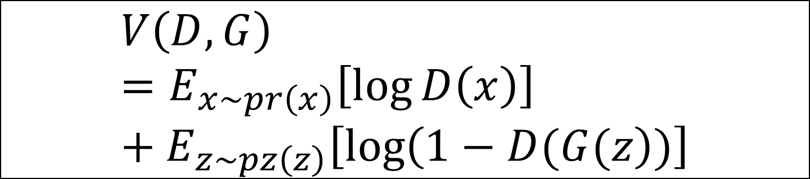
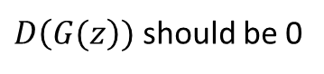
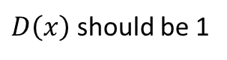
Fundaments
Objection function of GAN
$$\min_{G}{\max_{D}{V\left(D,G\right)}}$$
$D\left(x\right)$ should be 1
When training D:
$D\left(G(z\right))$ should be 0
$$V\left(D,G\right)=E_{x\sim pr\left(x\right)}\left[\log{D\left(x\right)}\right]+E_{z\sim pz\left(z\right)}\left[\log\left(1−D(G(z\right))\right]$$

Slide 13
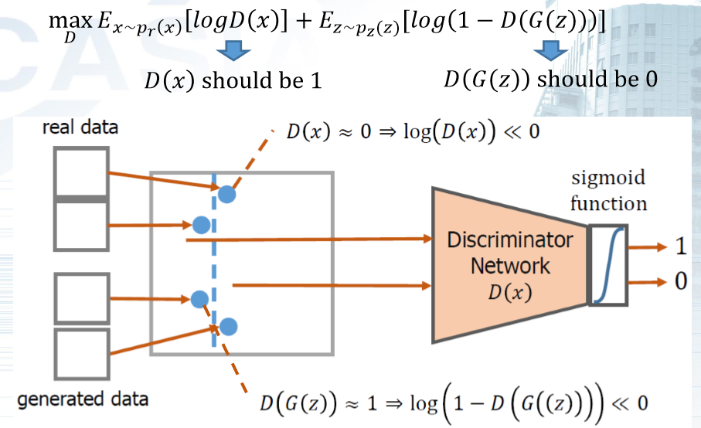
Fundaments

Slide 14
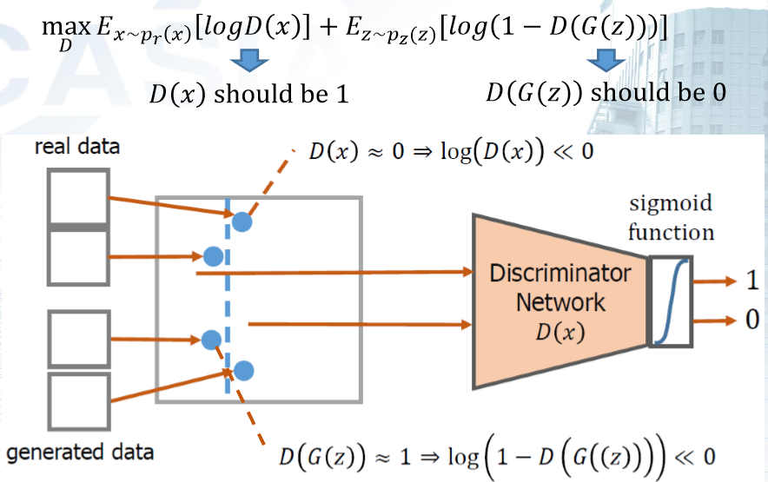
Fundaments

Slide 15
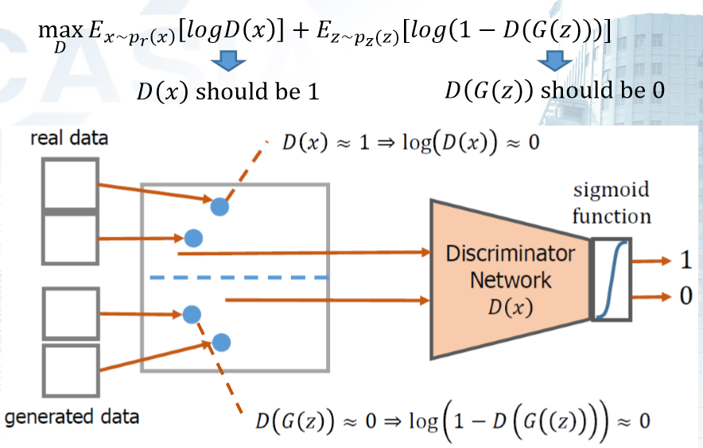
Fundaments

Slide 16
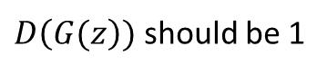
Fundaments
Objection function of GAN
$$\min_{G}{\max_{D}{V\left(D,G\right)}}$$
When training G:
$D\left(G(z\right))$ should be 1
$$V\left(D,G\right)=E_{x\sim pr\left(x\right)}\left[\log{D\left(x\right)}\right]+E_{z\sim pz\left(z\right)}\left[\log\left(1−D(G(z\right))\right]$$

Slide 17
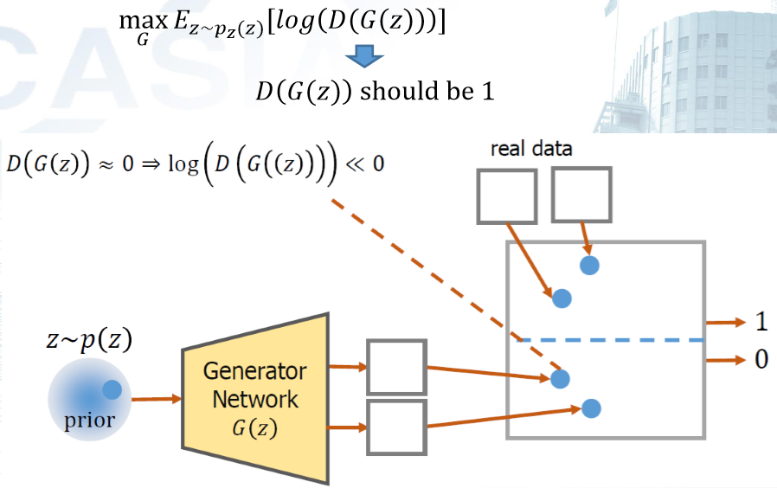
Fundaments

Slide 18
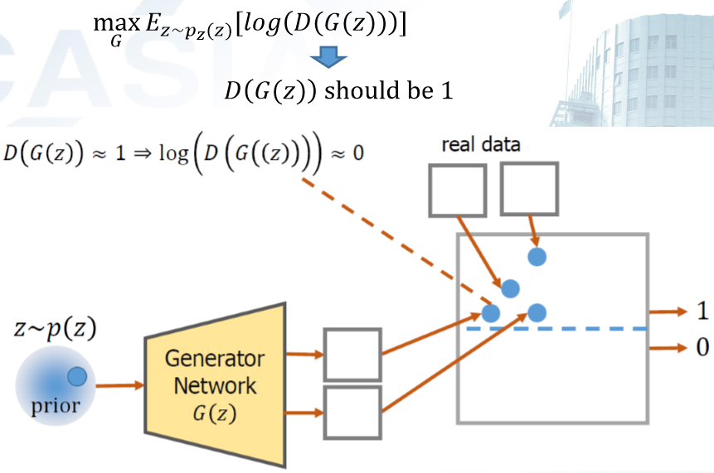
Fundaments

Slide 19
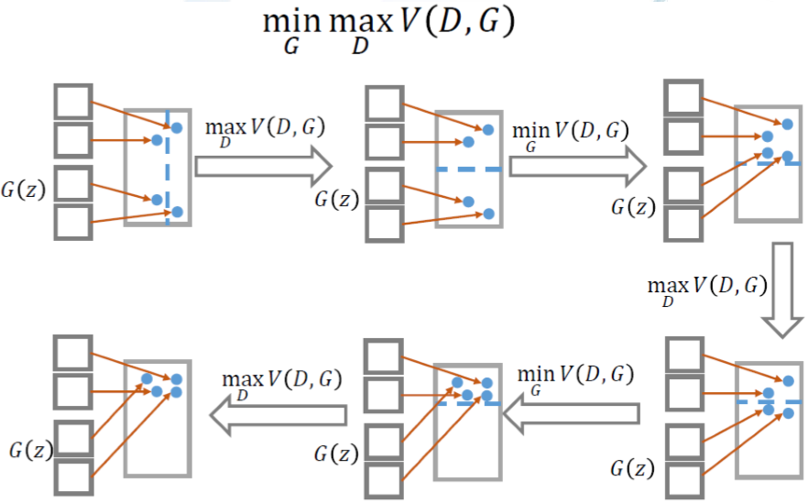
Fundaments

Slide 20
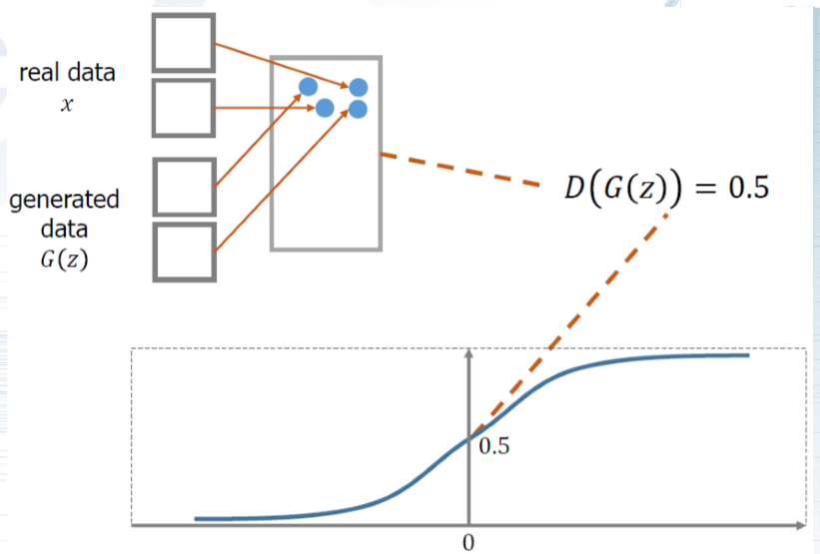
Fundaments
Global Optimal

Slide 21
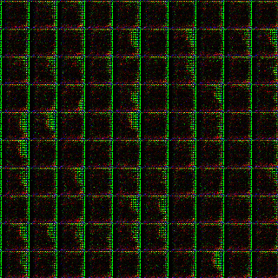
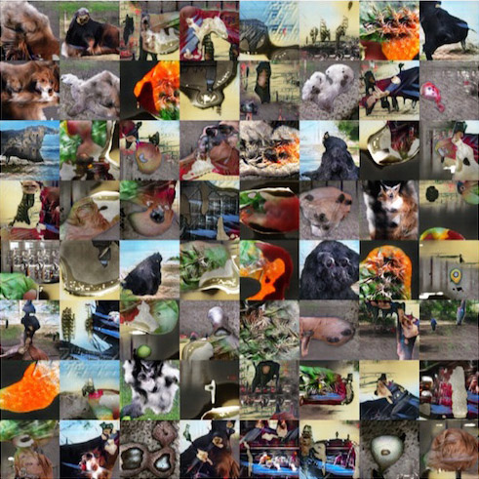
DCGAN

Slide 22
OUTLINES
1
Generative Models
2
Fundaments
3
GAN Extensions
4
Discussion

Slide 23
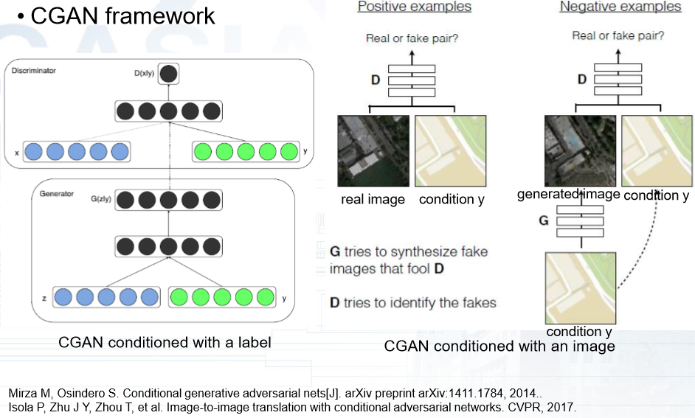
GAN Extensions
Conditional GAN (CGAN)

Slide 24
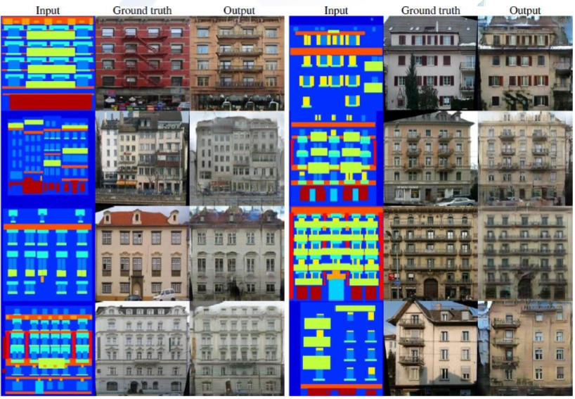
GAN Extensions
Conditional GAN (CGAN)

Slide 25
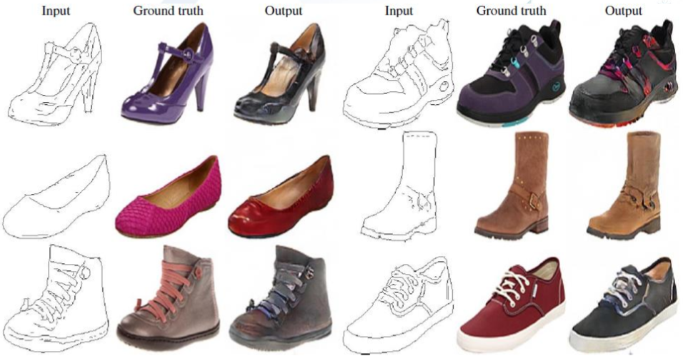
GAN Extensions
Conditional GAN (CGAN)

Slide 26
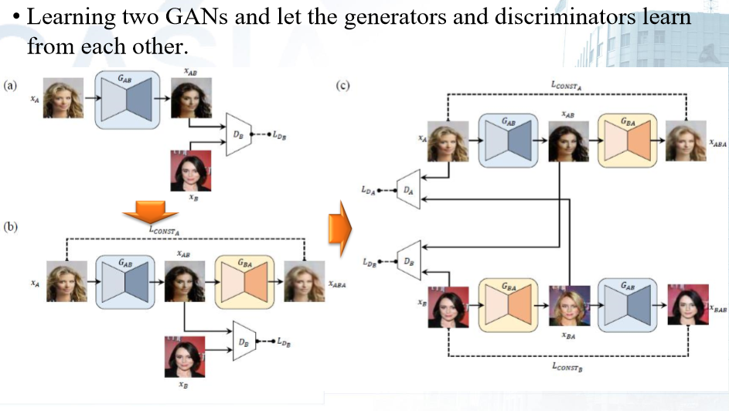
GAN Extensions
Discover Cross-domain relations GAN (DiscoGAN)

Slide 27
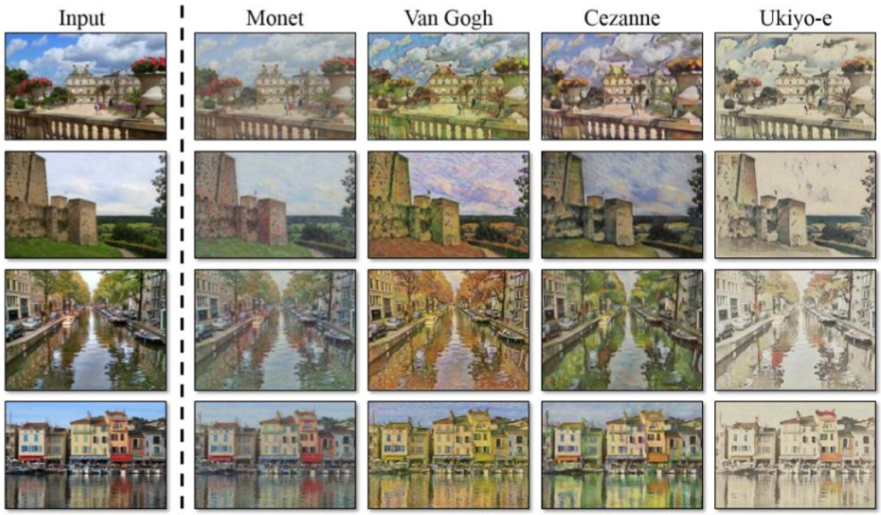
GAN Extensions
Discover Cross-domain relations GAN (DiscoGAN)

Slide 28
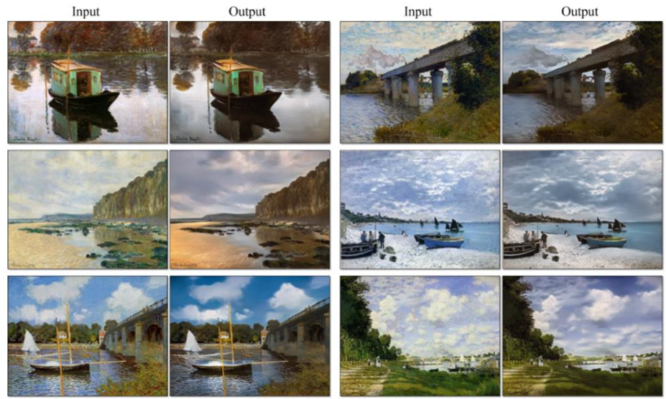
GAN Extensions
Discover Cross-domain relations GAN (DiscoGAN)

Slide 29
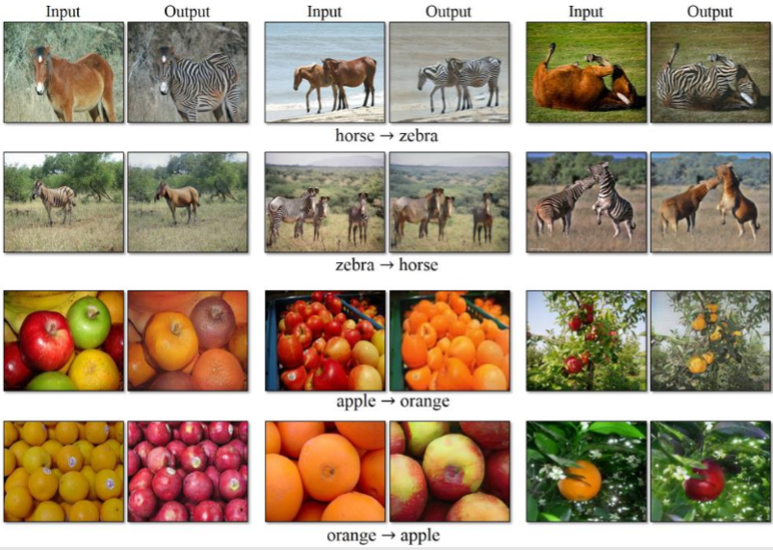
GAN Extensions
Discover Cross-domain relations GAN (DiscoGAN)

Slide 30
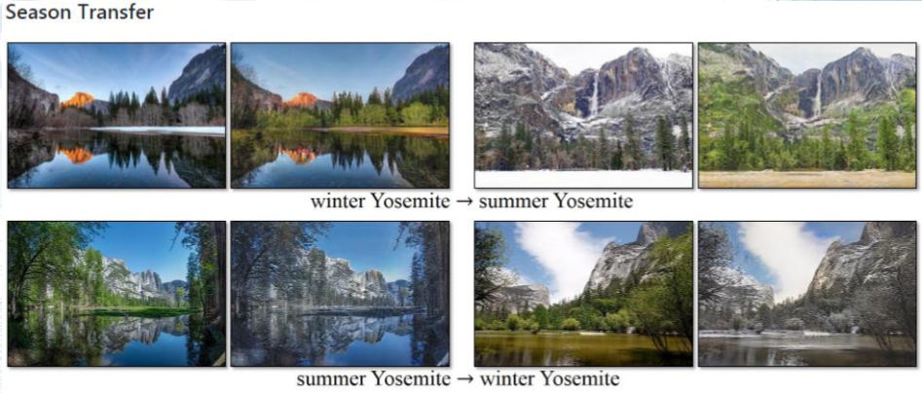
GAN Extensions
Discover Cross-domain relations GAN (DiscoGAN)

Slide 31
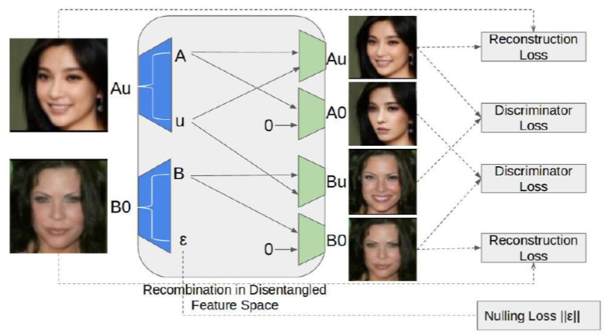
GAN Extensions
GeneGAN: feature disentanglement

Slide 32
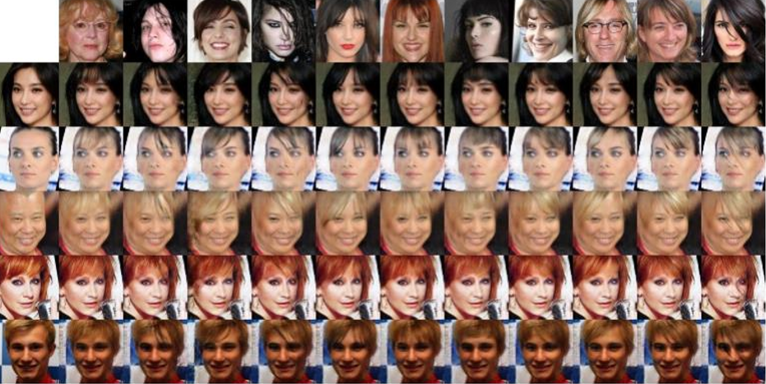
GAN Extensions
GeneGAN: feature disentanglement

Slide 33
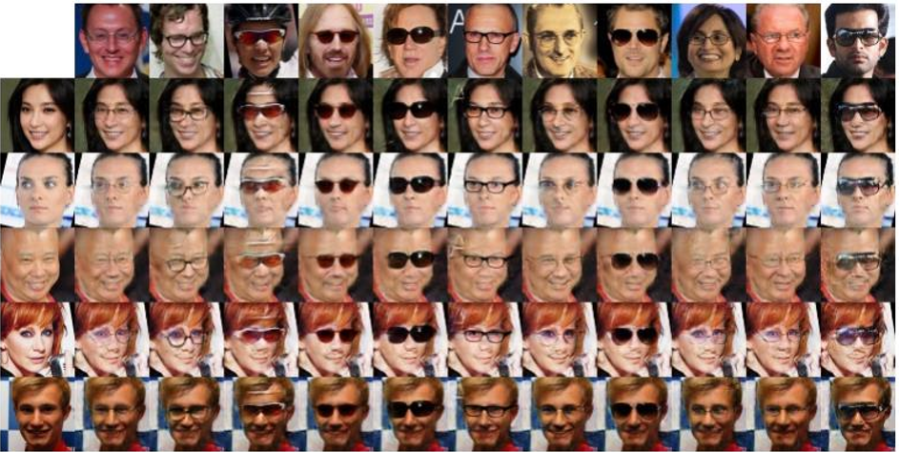
GAN Extensions
GeneGAN: feature disentanglement

Slide 34
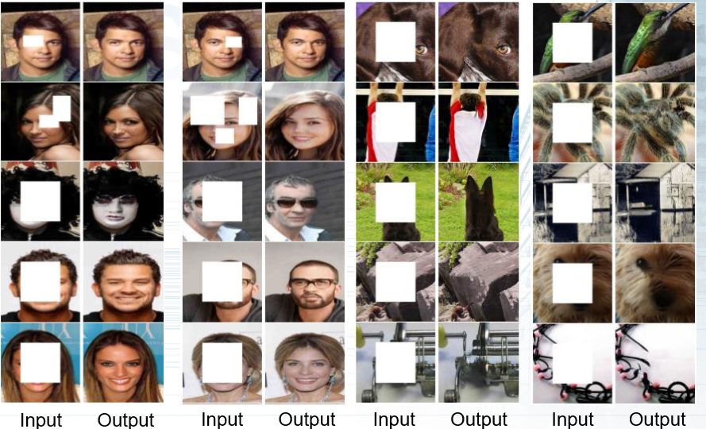
GAN Extensions
Image Inpainting

Slide 35
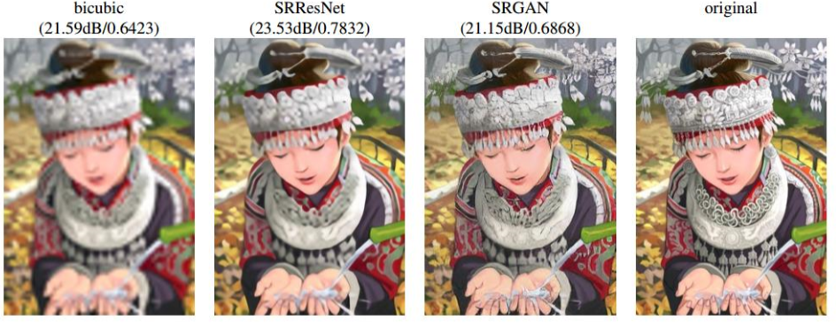
GAN Extensions
Super Resolution

Slide 36
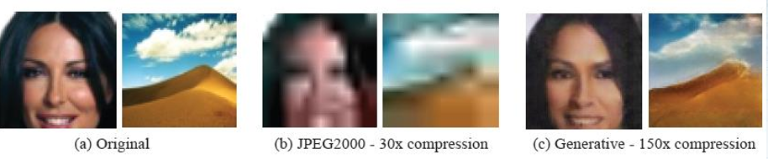
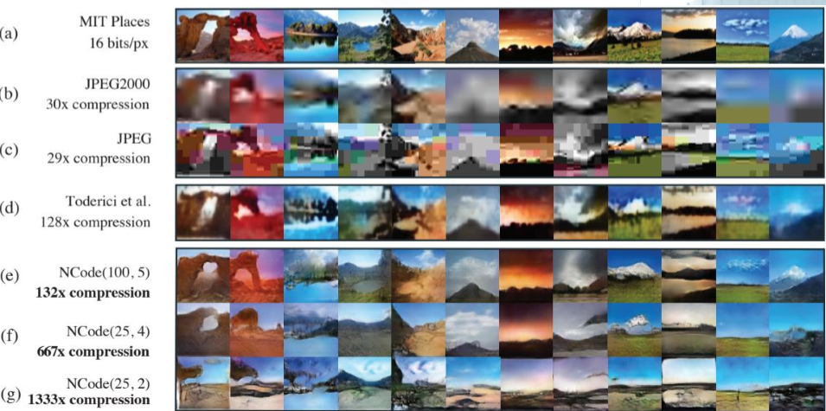
GAN Extensions
Compression

Slide 37
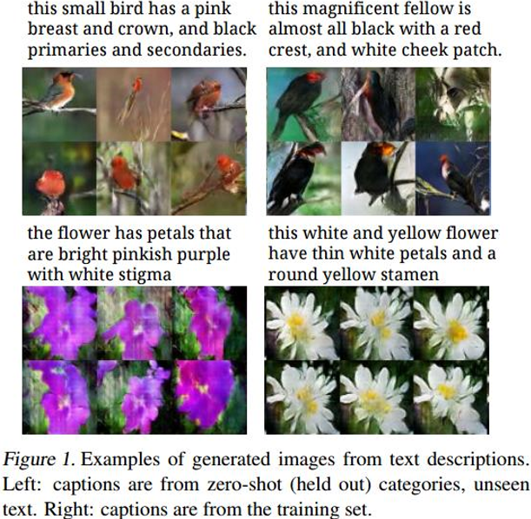
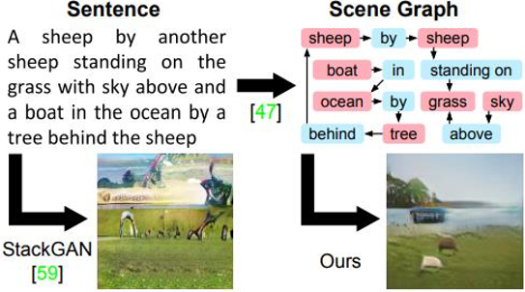
GAN Extensions
Text to Image

Slide 38
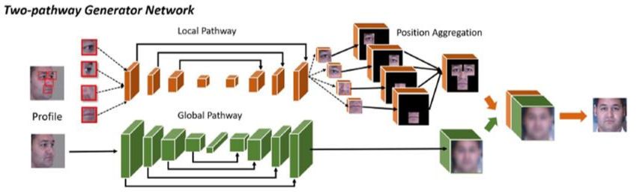
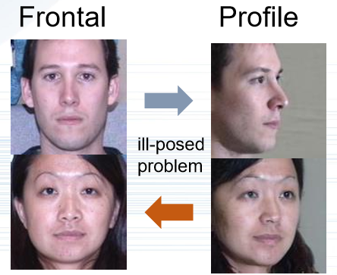
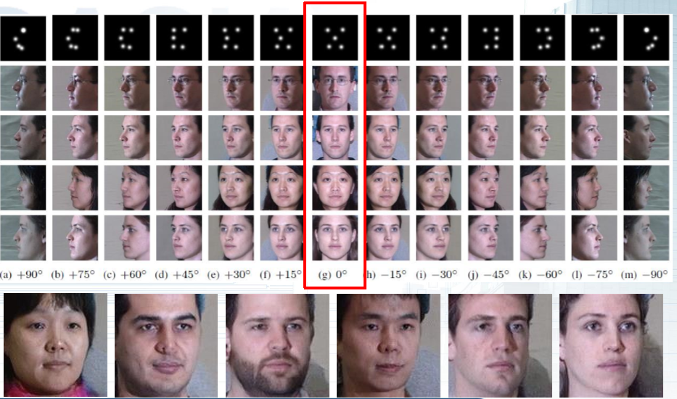
GAN Extensions
Face Rotation

Slide 39
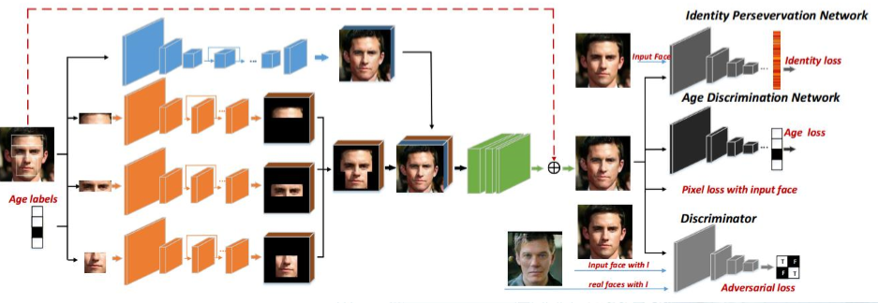
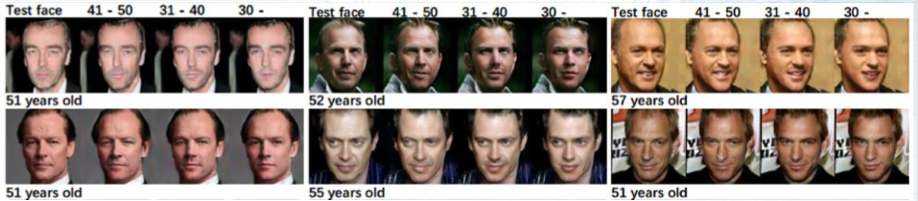
GAN Extensions
Face Aging

Slide 40
OUTLINES
1
Generative Models
2
Fundaments
3
Generative Adversarial Networks
4
Discussion

Slide 41

Discussion

